Slide 1
MY MUSIC
SUBMITTED BY :
Kartavya (484)
Karan Kumar Garg (478)
Jasmeet Singh (449)
Joyash Sood (466)
SUBMITTED TO:
Dr. Baljit Kaur

Slide 2
Table of Contents:
Introduction
Problem Statement
Technical Details
Key Features
Project Highlights
Bonus Feature(optional)
Conclusion
References/Links used

Slide 3
Introduction
A music player is a digital device or software application designed to play audio files.
Best way to relieve pressure in stressful modern society life.
The purpose of this project is to develop a player which can play the mainstream file format.
It stimulates emotions, fostering relaxation or energizing the listener.
Cognitive benefits include improved memory, focus, and creativity. Socially, it connects people, facilitating communication and community bonding.
Physiologically, music can reduce stress, lower blood pressure, and enhance overall well-being.

Slide 4
OVERVIEW
Meanwhile, this software can play, pause and select songs with the help of buttons according to your requirement as well as set up songs.
It serves as a convenient tool for accessing and enjoying a wide range of music content.
Whether it's stored locally on a device or streamed from online platforms, a music player provides users with the ability to create playlists, shuffle tracks, and adjust playback settings according to their preferences.
With intuitive user interfaces and features like album artwork display and customizable equalizer settings, music players offer an immersive listening experience.
From personal enjoyment to background ambiance, music players cater to diverse needs and enhance the way we engage with music.

Slide 5
Problem Statement-
Even though we have music player in our androids yet we require online streaming of songs? Why?
Problem:
Downloading each song can be pretty space consuming.
Creating albums according to our song requirements is time consuming.
Song range is limited.
Downloading songs can lead to virus threats.
Playlists created by user1 can’t be shared directly to some other user.
We cant find artists of our favourite genre
Playlist is not upto date.
Song management is not smooth

Slide 6
Technical Details-
User Interface:
Music players have graphical user interfaces (GUI) that allow users
to interact with the player.
The user interface can include features such as playlists and
visualizations.
Audio Outputs:
Music players use audio outputs such as speakers, headphones, and digital audio outputs to play back audio.

Slide 7
Technologies….
Storage Devices:
Music players can store music files on various types of storage devices such
as hard drives, solid-state drives, and memory cards.
Wireless Technologies:
Music players can connect to other devices wirelessly using technologies
such as Bluetooth and Wi-Fi.

Slide 8
Key Features-
Play, pause, and stop buttons
Progress bar
Volume control
Playlist
Album artwork display
Crossfade
Customizable themes

Slide 9
Project Highlights
HTML CODE:
HTML (Hypertext Markup Language) is a markup language used for creating web pages.
It provides the structure and content of a web page, including headings, paragraphs, images, and links.
In the project, HTML was used to create the layout of the countdown timer, including the placement and styling of the various elements such as the input fields and the countdown display.

Slide 10
HTML continued…
It is the backbone of web pages, providing the structure and content that browsers render.
It consists of elements enclosed in tags, defining headings, paragraphs, links, images, and more.
Tags can have attributes for additional information.
HTML works alongside CSS for styling and presentation, ensuring compatibility across browsers and devices.
Developers use HTML to create forms, embed content, and validate code for standards compliance, contributing to the dynamic evolution of the web.

Slide 11
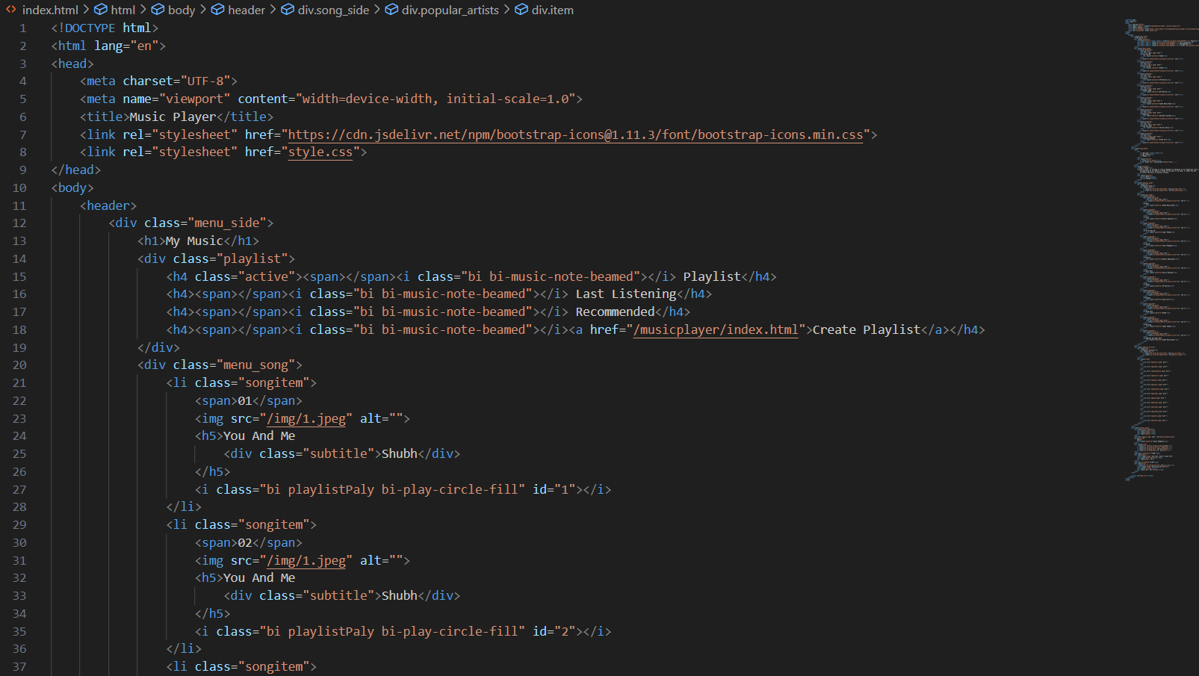

Slide 12
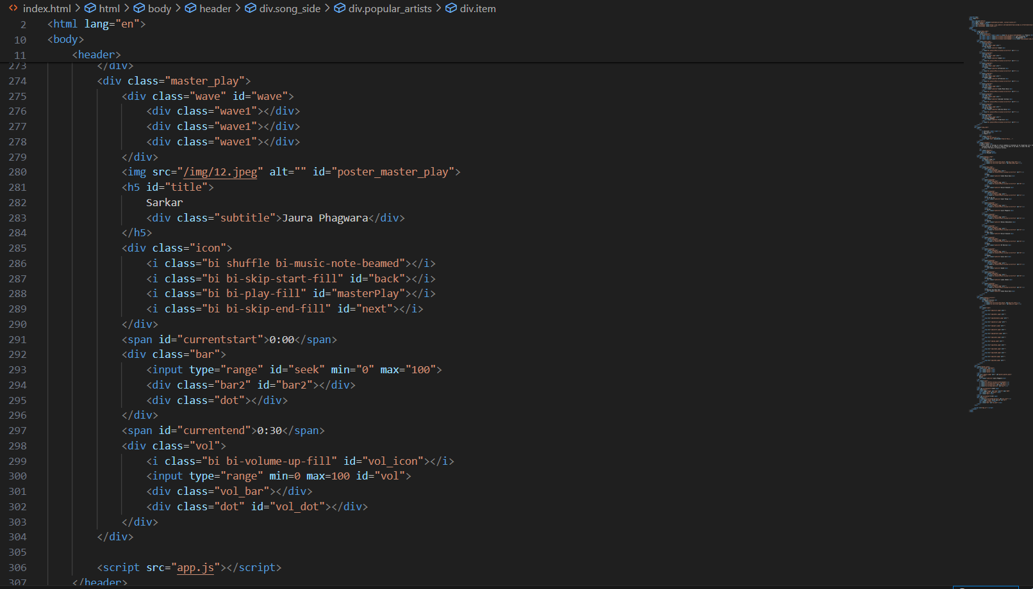

Slide 13
CSS
It is used for styling the webpage we have used CSS.
It controls the layout, design, and visual appearance of web pages, including elements' colors, fonts, spacing, and positioning.
CSS works by targeting HTML elements and applying styles to them through selectors, properties, and values.
Selectors identify which elements the styles should be applied to, while properties specify the visual characteristics to change, and values define the specific settings for those properties.
CSS allows for separation of content from presentation, facilitating consistent and flexible design across multiple pages or devices.

Slide 14
CSS continued…
In container, we’ve have used flex property for aligning the elements in centre, background colour, text colour and adjusted the width and height as per the requirement.
In text area, we styled the font by using font size and font family.
In output box division we added flex property space between and adjusted the width and height as per our need

Slide 15
JAVASCRIPT
JavaScript is a versatile programming language primarily used for web development.
It runs in web browsers, enabling dynamic interaction with web pages.
Executed on the client side, it operates within the user's browser, enabling actions such as form validation, animations, and responsive interfaces.
JavaScript interacts with the Document Object Model (DOM), to manipulate elements dynamically.
It supports event-driven programming, responding to user actions like clicks and keystrokes.
JavaScript can also communicate with web servers asynchronously, facilitating data retrieval and updates without reloading the entire page.
Its flexibility and ubiquity make it fundamental to modern web development.

Slide 16
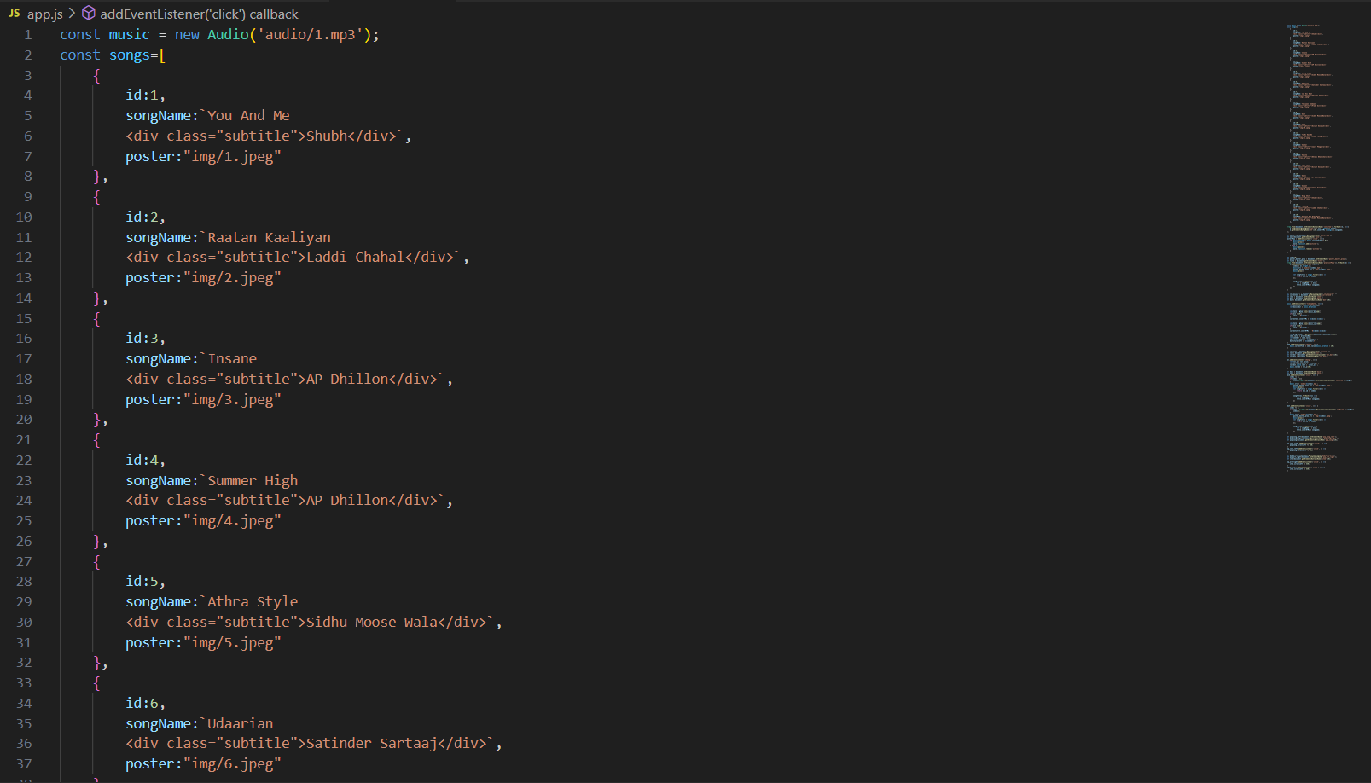
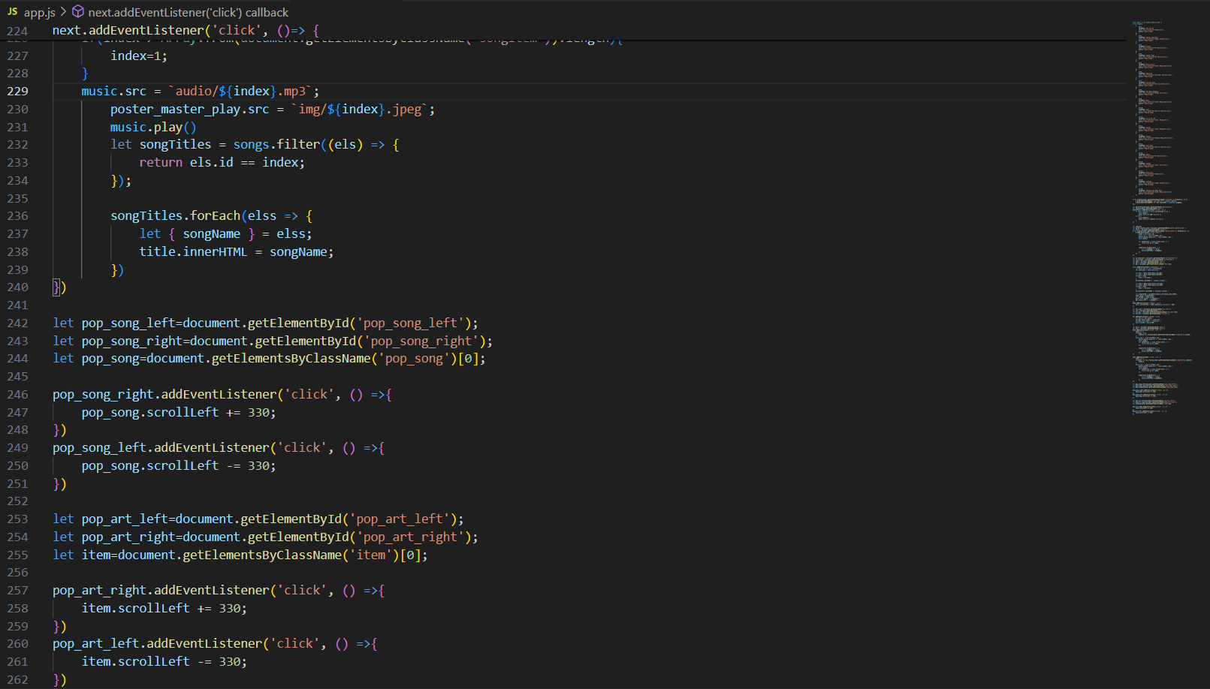
JAVASCRIPT CODE:

Slide 17
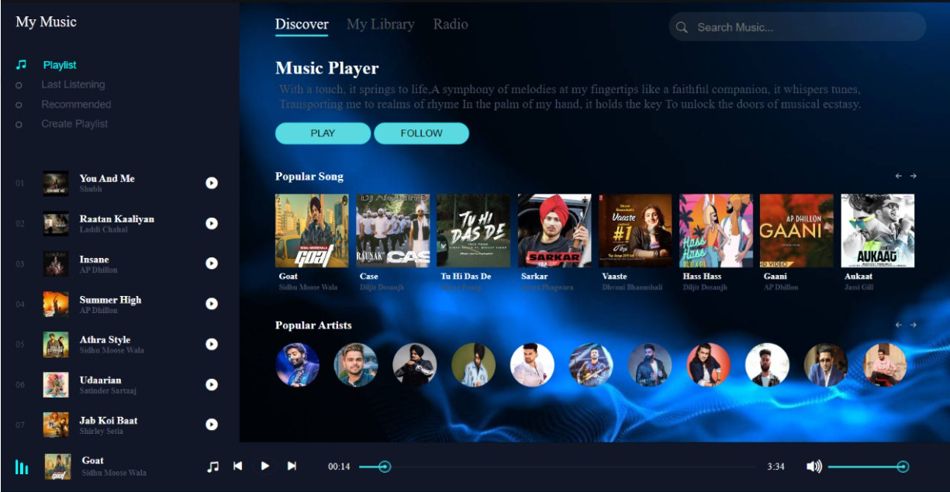
OUTPUT OF OUR CODE:
MULTIPLAYER

Slide 18
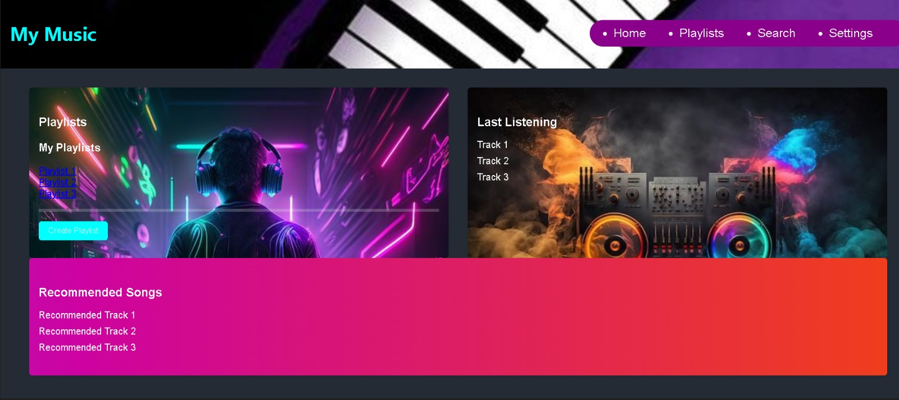

Slide 19
Bonus Features-
Our project provides a feature to store the user’s selected music albums as playlist so that they can enjoy their music anytime, anywhere.
We also keep records of their ‘recently played’ songs so that they can access their past played music and listen them again.
We provide a feature for ‘liked music’ which enables them to see all their selected liked music.

Slide 20
Conclusion-
The project was a music player, which involved
designing and developing software to play audio files on web.
Key features of Music Player include -:
A user-friendly interface,
Support for different file formats,
Smooth transitions,
The ability to create and manage playlists,
Playback settings.

Slide 21
References/Links used
References of this project have been taken from the below mentioned sites-
https://music.youtube.com/
https://open.spotify.com/
https://www.jiosaavn.com/
https://music.apple.com/us/browse

Slide 22


